Slide 1
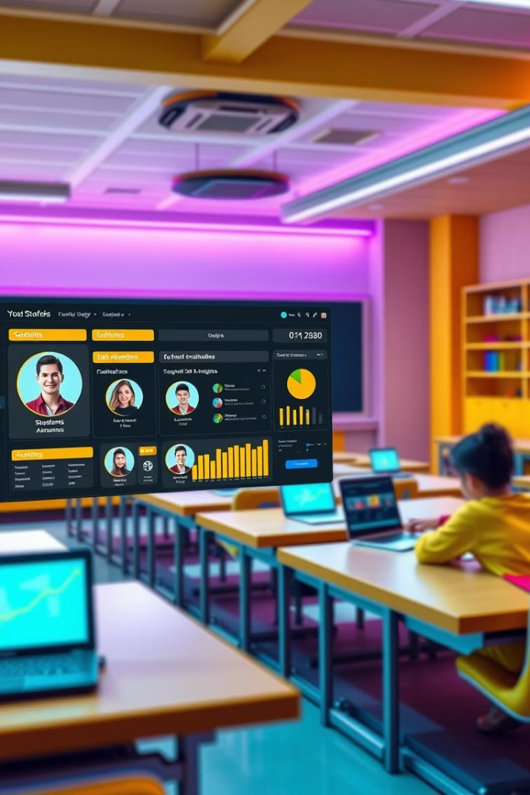

Project 9: Student Management System
Streamlining Education Through Technology.
Enhancing Administrative Efficiency and Student Success.
by Kavya Sree

Slide 2
What is a Student Management System (SMS)?
Definition
Key Features
Software to manage student data and administrative tasks.
Enrollment, attendance, grading, communication.
Market size: $22.8B in 2023.
Streamlines operations.
Projected 11.8% CAGR through 2030.
Improves educational experience.

Slide 3

Core Features of an SMS
Student Enrollment
Attendance Tracking
Online applications.
Automated logs.
Document management.
Absence reporting.
Grade Management
Communication Portal
Gradebooks.
Announcements and messaging.
Report card generation.
Parent-teacher interaction.
GPA calculation.

Slide 4
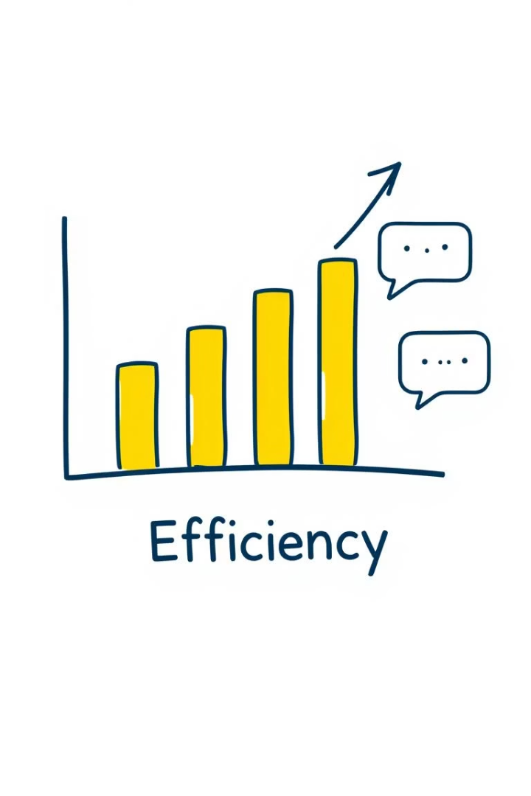
Benefits of Implementing an SMS
60%
Reduced Paperwork
Automates manual tasks.
45%
Minimized Errors
Centralized data.
$15K
Cost Savings
Reduced overhead.
15%
Improved Graduation Rates
Better decision-making.

Slide 5





Implementation Considerations
Needs Analysis
Identify specific requirements.
Data Migration
Seamless transfer.
System Integration
Integrate with existing platforms.
User Training
Comprehensive training.
Security Measures
Data encryption.

Slide 6
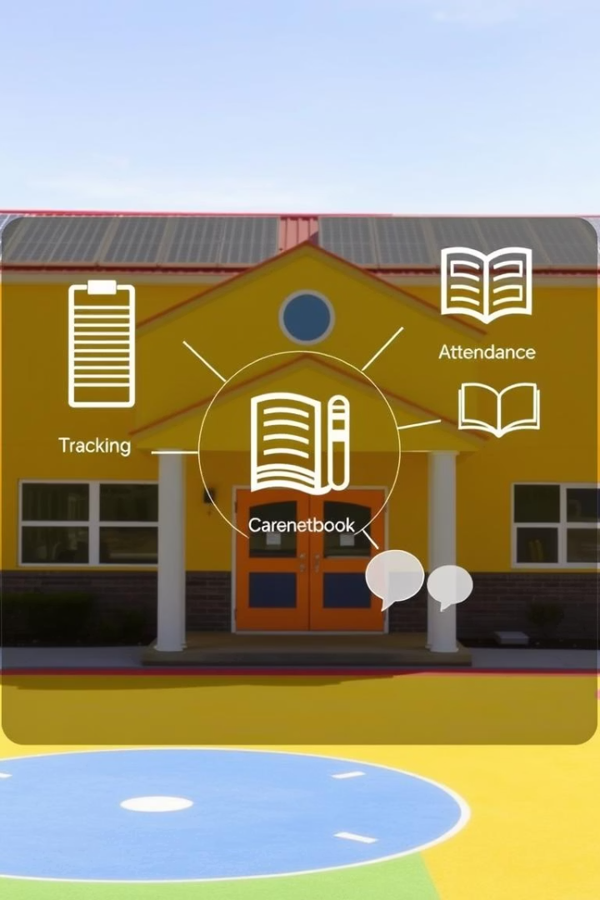
Case Study: SMS Implementation at a K-12 School
1
Challenges Faced
2
Solution Implemented
Manual processes.
Communication gaps.
EduManage Pro SMS.
Data inaccuracies.
Cost: $20,000.
3
Key Results
70% admin task reduction.
50% parent engagement increase.
90% data accuracy.
ROI within 18 months.

Slide 7





Future Trends in Student Management Systems
Cloud-Based
Mobile Access
AI Integration
Scalability, accessibility, reduced IT costs.
Apps, on-the-go availability.
Personalized learning, predictive analytics.
Data Analytics
Performance tracking, insights.

Slide 8

Conclusion: Empowering Education with Technology
SMS is Vital
For modern educational institutions.
Key Benefits
Efficiency, communication, data accuracy, cost savings.
Future Focus
Cloud, mobile, AI, data analytics, cybersecurity.
Call to Action
Embrace technology.

